Slide 1
Other
Experimental
Design

Slide 2
EXPERIMENTS
Completely Randomized Design
Matched Pairs Design
Randomized Block Design

Slide 3
Experimental Units
Randomly Assign
Treatment Group
1
Treatment Group
2
Treatment
level 1
John
Treatment
Level 2
Jennifer
Compare
Notes:
先来回顾一下上周学习的 completely randomized design.
我们一共有127个faculty members，随机从中选取63个人接受第一种treatment，也就是john的简历
剩下的接受Jennifer的简历
最后比较两组给出的hireability ratings and estimated starting salary

Slide 4
Completely randomized design:
An experimental design in which experimental units are assigned to treatments completely at random.
This is the “SRS” of experiments
the simplest but still effective
Notes:
Def
这个在实验设计里的地位和抽样方法中的SRS类似

Slide 5

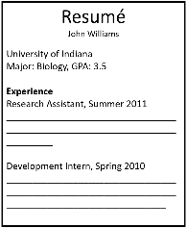
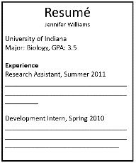
If all faculty members were from both Tier 1 and Tier 2 Universities…
Tier 1
Tier 1
Tier 1
Tier 2
Tier 1
Tier 2
Tier 2
Tier 2
Tier 1
Tier 1
Tier 2
Tier 2
John
Jennifer
Notes:
现在简化一下问题，我们只有12个人来参与实验
6个人拿John的，6个人拿Jennifer的，他们都是来自于两个水平差异很大的实验室的研究员

Slide 6
Variation in Random Assignment
Overlap
John
There is some difference but also some overlap.
The differences may be due to chance alone.
1
2
3
4
5
6
7
Jennifer
1
2
3
4
5
6
7
“hireability” rating
Notes:
我们得到的hireability rating如图所示，
我们得到这样的结论：There is some difference but also some overlap. The differences may be due to chance alone. 有可能只是由于随机性，偶然得到的，也许本质上他们的rating并没有差别。

Slide 7
Variation in Random Assignment
John
1
2
When broken down by Tier, there is little overlap. Schools within each tier rated John more ‘hireable.’
3
4
5
6
7
Jennifer
1
2
3
4
5
6
7
“hireability” rating
Notes:
When broken down by Tier, there is little overlap. 重叠的部分很小，我们发现在每个实验室里，John的评分都会比Jennifer显著高很多

Slide 8
Reduce the variability due to school tier!
Notes:
所以如果我们把实验室分类之后再进行实验，就可以reduce the variability due to school tier.

Slide 9
Randomized Block Design:
Experimental units are first blocked (grouped) by a similar trait that may affect response.
Then, units from each block are randomly assigned to treatment.
This is the “stratified sample” of experiments
It reduces variation between treatment groups at the start of the experiment. This makes it easier to show that differences in response are really due to treatment, rather than chance.

Slide 10

“Describe a randomized block design”
Tier 2
Tier 1
Tier 1
Tier 2
Block the science lab faculty members by University tier.
In each block, assign each faculty member a number 1 – 6.
Tier 2
Tier 1
Tier 1
Tier 2
Tier 2
Tier 1
Tier 1
Tier 2
n = 12

Slide 11
“Describe a randomized block…”
Tier 1
3
4
Block the science lab faculty members by University tier.
In each block, assign each faculty member a number 1 – 6.
1
5
2
6
Tier 2
3
4
1
5
2
6

Slide 12
“Describe a randomized block…”
For the Tier 1 block, use the random number generator to select 3 distinct numbers from 1 to 6.
The corresponding faculty are assigned ‘Jennifer’ application materials. The remaining are assigned ‘John’ materials.
Tier 1
3
4
1
5
2
6
Tier 2
3
4
1
5
2
6

Slide 13
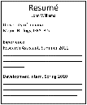
“Describe a randomized block…”
Tier 1
John
3
4
1
Jennifer
5
2
6
Tier 2
3
4
1
5
2
6

Slide 14
“Describe a randomized block…”
John
2
1
4
Tier 1
Jennifer
3
5
6
Tier 2
3
4
1
5
2
6

Slide 15
“Describe a randomized block…”
Tier 1
Repeat the same random assignment process for the Tier 2 block.
John
2
1
4
Tier 1
Jennifer
3
5
6
Tier 2
3
4
1
5
2
6

Slide 16
“Describe a randomized block…”
John
2
1
4
Tier 1
Jennifer
3
5
6
John
Tier 2
5
2
3
Jennifer
4
1
6

Slide 17
“Describe a randomized block…”
Compare ‘hireability’ ratings between the Jenn/John groups within each block.
John
2
1
4
Tier 1
Jennifer
3
5
6
John
Tier 2
Compare ‘hireability’ ratings between the Jenn/John groups within each block.
5
2
3
Jennifer
4
1
6

Slide 18
“Describe a randomized block…”
Compare ‘hireability’ ratings between the Jenn/John groups within each block.
John
2
1
4
Tier 1
Jennifer
Combine the results, after accounting for the average difference in each block.
3
5
6
John
Tier 2
Compare ‘hireability’ ratings between the Jenn/John groups within each block.
5
2
3
Jennifer
4
1
6

Slide 19
Block 1
Block n
Group 1
Experimental
Units
Group 2
Group m
……
Group 1
Treatment m
Treatment 1
Treatment 2
Treatment 1
Group 2
Treatment 2
……
Group m
Treatment m
Compare
Conclusion
Compare

Slide 20
(a)
Assign each YouTube user a number from 1 to 300.
Use the random number generator to select 100 distinct numbers from 1-300. The corresponding users are assigned Advertisement #1. Use the random number generator to select 100 distinct numbers, ignoring the numbers has been chosen already for the first Advertisement group. The corresponding users are assigned Advertisement #2. The remaining users are assigned Advertisement #3.
Compare the effectiveness of the three advertisement groups.

Slide 21
(b)
Block the 300 YouTube users by age: Younger and Older.
In each block, assign each YouTube user a number from 1 to 150. For the younger block, use the random number generator to select 50 distinct numbers from 1-150. The corresponding users are assigned Advertisement #1. Use the random number generator to select 50 distinct numbers from 1-150, ignoring the numbers has been chosen already for the first Advertisement group. The corresponding users are assigned Advertisement #2. The remaining users are assigned Advertisement #3.
Repeat the same random assignment process for the older group.
Compare the effectiveness of the three advertisement groups in each block. Combine the results from two blocks.

Slide 22
(c)
The block design helps to control age as a confounding variable. Within each block, there will be lower variability of results making it easier to determine which advertisement is most effective.

Slide 23
Topics
Blocking
Matched pairs design
Blinding and placebo
Generalizing study results

Slide 24
Studying Depression
Depression arises from a complex interaction of biological, psychological, and social factors.
Knowing which factor is most influential could help treatment..
Which factor is the most prominent cause of depression?
Notes:
我们这节课接触的实例是关于depression的一个研究，他们的出发点是觉得，引起Depression的原因有很多也很复杂，biological, psychological, and social factors，所以他们觉得如果能够找到引起depression的主要因素，对于治疗过程是很有帮助的。
这个实验想要研究的第一个因素就是：心理暗示。
他们想研究心理暗示是否对于depression有影响
Treatment是“有心理暗示”
那我们会有一个对照组就是，没有心理暗示
那么我们会观察这两组结果是否有显著差异，如果有的话就说明，心理暗示是depression的一个原因。反之，因果关系就不成立。

Slide 25
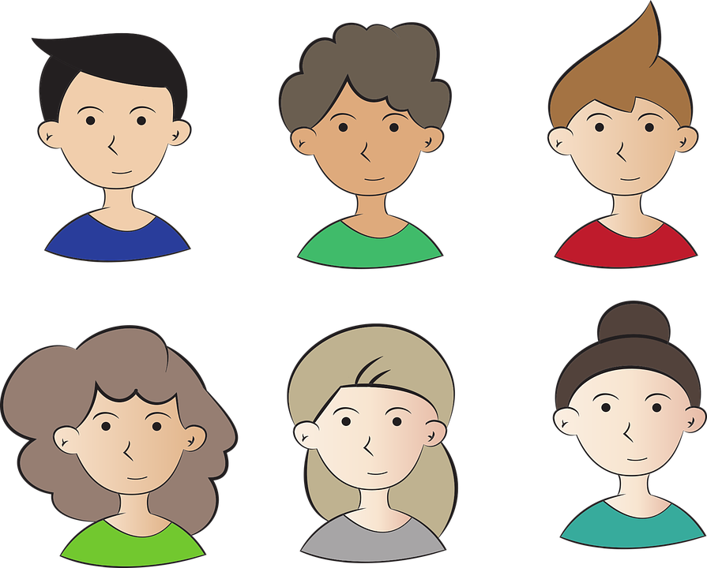
Any confounding variables？
Notes:
假设这个实验一共有六个病人参与，我们怎么来设置treatment group，也就是接受心理暗示的组。
这里面会不会有confounding Variables？也就是除了“心理暗示”这个变量以外，还会不会有因素，能对最后的治疗结果产生影响。
怎么去控制所有的confounding Variables都一致？
How to set a control group in this case?

Slide 26
Difficult to control confounding variables.
Individuals have different:
Levels of depression
Types of depressive symptoms
Array of biochemical, psychological, and environmental conditions
Side-effects from treatment
Notes:
我们发现因为每个人的levels of depression,….都不一样，所以很难控制住所有的confounding Variables
那我们怎么办，有没有办法排除这些因为个体差异对结果产生的影响？

Slide 27
Matched pairs design
Subjects are their own control group!
Notes:
他们自己作为自己的control group
也就是说对于同一个人，我可以同时给他两个treatments/多个treatments？

Slide 28
Matched Pairs Design: (a type of randomized blocked experiment )
each block is composed of two similar experimental units (a “matched pair”).
Often, the “matched pair” is simply the same experimental unit receiving both treatments.
The order of the treatments is randomized.
Notes:
这种实验方法就叫做Matched Pairs Design.
这是一种特殊的block design，每个人都作为一个block
Def
Often, the “matched pair” is simply the same experimental unit receiving both treatments.
The order of the treatments is randomized. 如果我们都是先给了心理暗示，再不给心理暗示，那我们并不能保证在第二个treatment实施之后产生的结果是不受第一个treatment影响的。
比如：我现在想试用一种新药，对于每个参与实验的人我都先给他吃原来的药，再吃新发明的药，那如果病人在吃玩新药之后，症状比之前有明显好转的话，我们可以说明新药更有效吗？ 有可能是因为旧药有延续作用。

Slide 29
Depression: Is it all in your head?
Researchers wanted to test if taking a “fake pill” would actually alleviate depression symptoms, even though the pill had no active ingredients.
35 people enrolled in study. All had major depression and none were taking any medications.
Notes:
这个实验想用fake pill作为treatment。

Slide 30
“Describe a matched pairs design”
Pill 2nd
Pill 1st
Pill 2nd
For each subject, flip a coin.
Heads indicate they get the fake pill for the first week and no pill for the second week.
Tails indicate the opposite treatment order.
Pill 1st
Pill 1st
Pill 2nd
n = 35 subjects

Slide 31
“Describe a matched pairs design”
Pill 2nd
Pill 1st
Pill 2nd
Have each subject fill out a depression questionnaire and undergo a PET brain scan at the end of each week.
Compare measurements for each subject and compile the results.
Pill 1st
Pill 1st
Pill 2nd
n = 35 subjects

Slide 32
Depression study results
1. On average, participants reported less severe depressive symptoms after their week with the fake pill.
2. On average, participants showed “increased µ-opioid receptor brain activity in regions of the brain associated with emotion and stress regulation.”*
Belief in the pill caused a biochemical change
*Study summary: https://www.nih.gov/news-events/nih-research-matters/placebo-effect-depression-treatment#:~:text=At%20the%20end%20of%20the,they%20took%20the%20inactive%20placebo.
Notes:
无论是表象还是指标上fake pill对于depression都有缓解

Slide 33
“Fake pills” have also shown significant beneficial effects for….
Migraines
Blood Pressure
Asthma
Arthritis
Many other ‘physical’ illnesses
Called the:
placebo effect
Source: https://www.ncbi.nlm.nih.gov/books/NBK513296/
Notes:
在其他方面，fake pills也有影响
我们在实验设计中，把这种影响叫做placebo effect

Slide 34
Topics
Blocking
Matched pairs design
Blinding and placebo
Generalizing study results

Slide 35
Placebo effect
Placebo: An inactive treatment (e.g. sugar pill)
Placebo effect: when subjects’ belief of receiving an active treatment leads to a measured response, even though the treatment is actually inactive.
Notes:
给出正式定义
那我们来看一个实验

Slide 36
Blinding
Single-blind study: either the subjects or the researchers are unaware of who receives active treatment or placebo.
Double-blind study: both the subjects and the researchers are unaware of who receives active treatment or placebo.

Slide 37
Blinding
Why blind subjects? Controls for placebo effect
Why blind researchers? Prevents confounding
Researchers trying to prove that a treatment works
may favor treatment group in their measurements
Notes:
Why blind subjects? Controls for placebo effect
如果有个实验想研究新药的效果，参与实验的人知道自己吃了药还是没吃的话，那肯定吃了药的人会给自己心理暗示。所以我们会给两组人员同时吃外观相同的两种药，一个成分有效，一个只是安慰剂，比如葡萄糖或者维生素。
Why blind researchers?
比如无意识的对参与实验的人暗示
比如：想调查人们更喜欢喝可口可乐还是百事可乐？
设计实验的人会随机给参与实验的人一杯可乐，实验人员是知道哪些是可口可乐，哪些是百事可乐的。在这个实验中，如果设计实验的人更偏向可口可乐，那他可能往可口可乐里放更多冰块，或者使可口可乐的杯子更靠近参与者，这些做法都会带来心理暗示。

Slide 38
Topics
Blocking
Matched pairs design
Blinding and placebo
Generalizing study results

Slide 39
Generalizing study results
Generalization: using study results to make inferences about a larger population.
Notes:
我们通过实验得出了结论，那这个结论是否可以被推广呢？
我们这个过程就涉及到我们的Experimental units 是否具有代表性了。

Slide 40
Generalizing study results
In the Jenn/John study, all faculty participants were from one of three science departments: biology, chemistry, or physics.
Discussion Question:
Can we generalize the result of gender hiring discrimination to all scientific subjects?

Slide 41
Discussion Question: Can we generalize the result of gender hiring discrimination to all scientific subjects? Explain your reasoning.
No. The faculty members in this study may not be representative of faculty from other science departments.

Slide 42
Were subjects randomly assigned to treatment?
 | Subjects were randomly assigned to groups (experiment) | Subjects were not randomly assigned to groups (observational study)
Subjects were randomly sampled from the population | Generalize to the population: ___ Determine cause and effect: ___ | Generalize to the population: ___ Determine cause and effect: ___
Subjects were not randomly sampled from the population | Generalize to the population: ___ Determine cause and effect: ___ | Generalize to the population: ___ Determine cause and effect: ___
Were subjects randomly sampled?
Notes:
Subjects were randomly assigned to groups (experiment)
有没有进行操作。

Slide 43
Were subjects randomly assigned to treatment?
 | Subjects were randomly assigned to groups (experiment) | Subjects were not randomly assigned to groups (observational study)
Subjects were randomly sampled from the population | Generalize to the population: Yes Determine cause and effect: Yes | Generalize to the population: Yes Determine cause and effect: No
Subjects were not randomly sampled from the population | Generalize to the population: No Determine cause and effect: Yes | Generalize to the population: No Determine cause and effect: No
Were subjects randomly sampled?

Slide 44
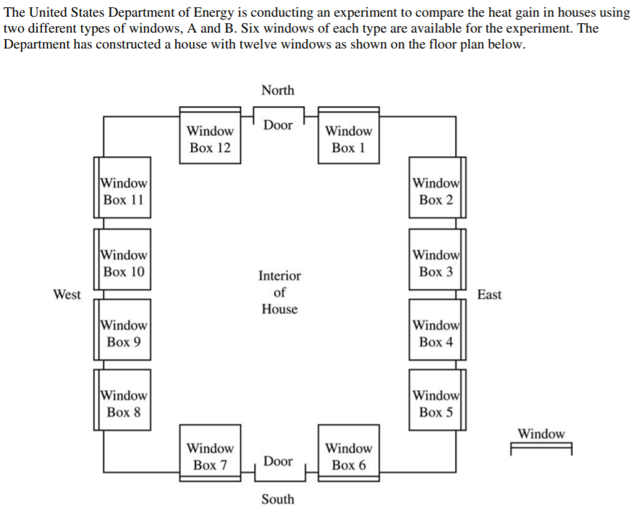
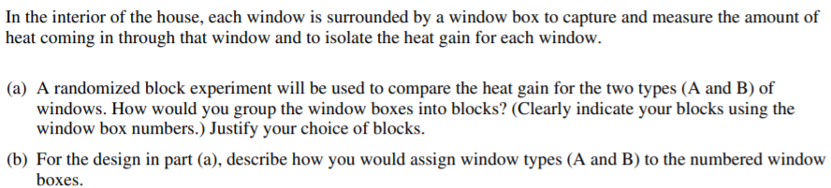

Slide 45
